Slide 1


Slide 2

This Photo by Unknown Author is licensed under CC BY-NC-ND

Slide 3
A and B together can complete a piece of work in 4 days. If A alone can complete the same work in 12 days, in how many days can B alone complete that work ?
(a) 4 (b) 6
(c) 8 (d) 12

Slide 4
(2) A does a work in 10 days and B does the same work in 15 days. In how many days they together will do the same work ?
(a) 5 days (b) 6 days
(c) 8 days (d) 9 day

Slide 5
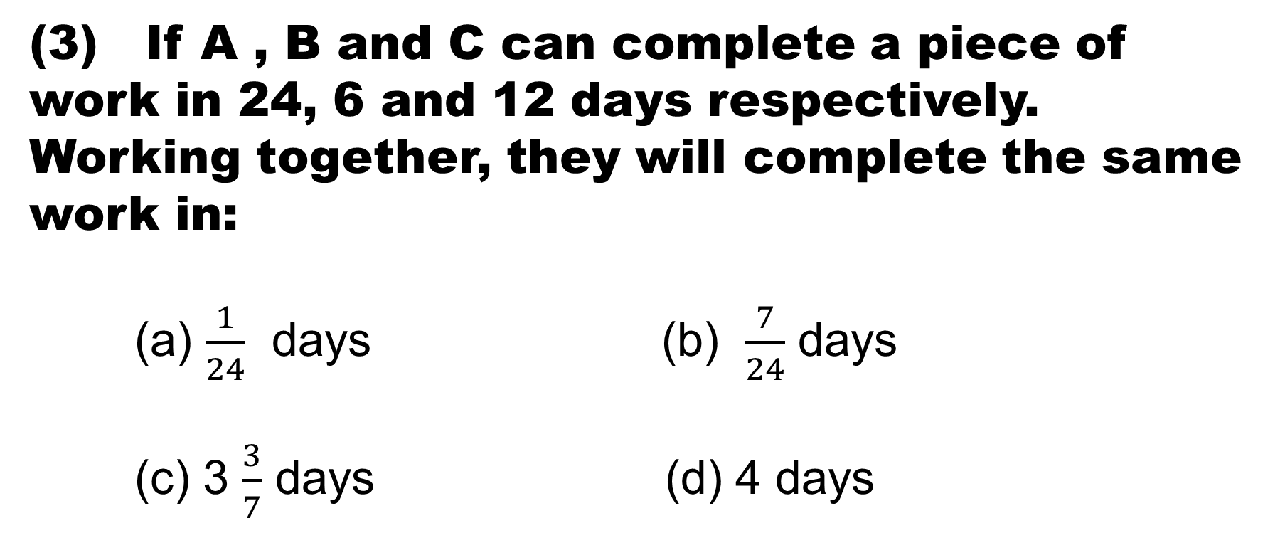
(3) If A , B and C can complete a piece of work in 24, 6 and 12 days respectively. Working together, they will complete the same work in:
(a) $\frac{1}{24}$ days (b) $\frac{7}{24}$ days
(c) 3 $\frac{3}{7}$ days (d) 4 days

Slide 6
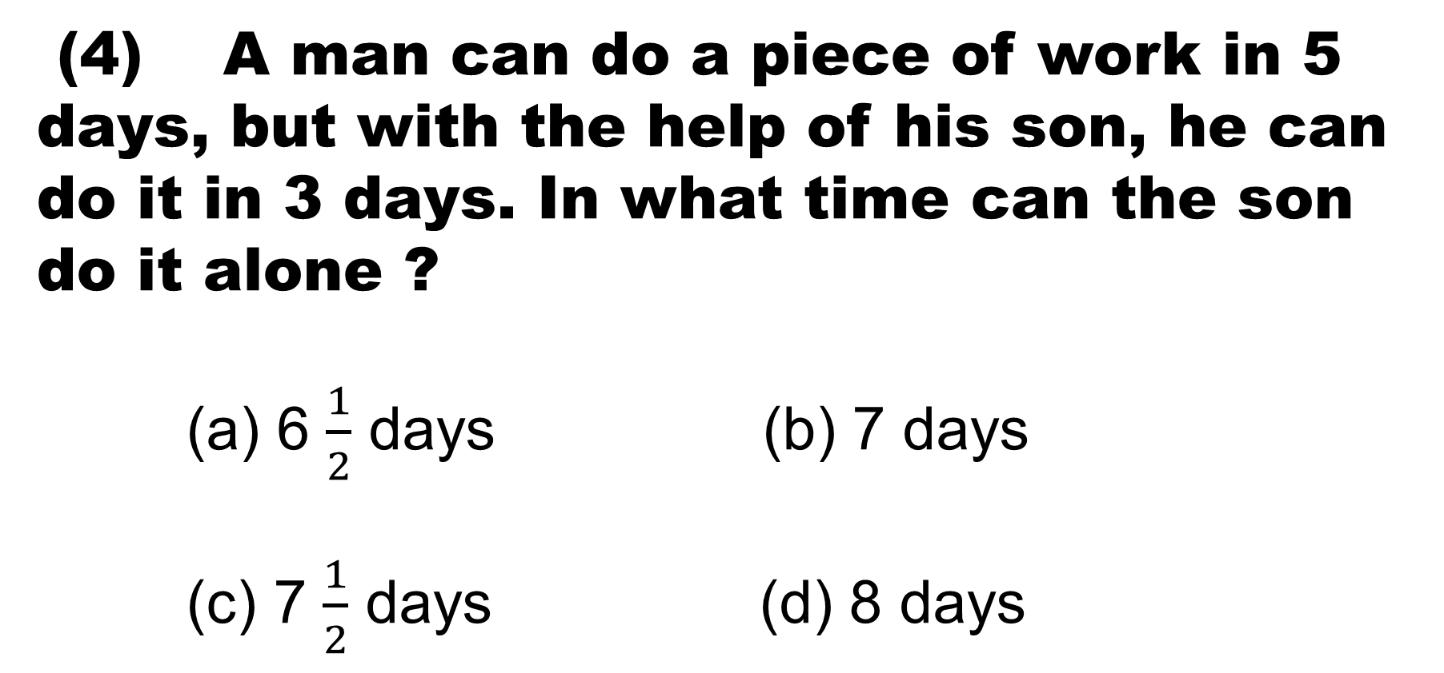
(4) A man can do a piece of work in 5 days, but with the help of his son, he can do it in 3 days. In what time can the son do it alone ?
(a) 6 $\frac{1}{2}$ days (b) 7 days
(c) 7 $\frac{1}{2}$ days (d) 8 days

Slide 7
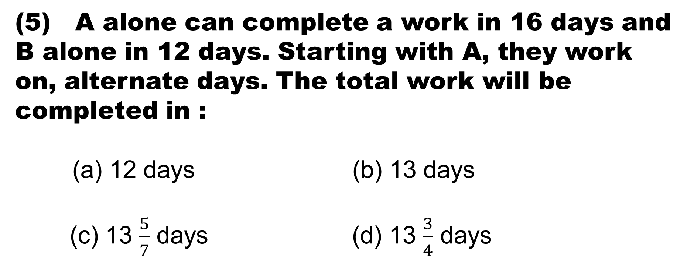
(5) A alone can complete a work in 16 days and B alone in 12 days. Starting with A, they work on, alternate days. The total work will be completed in :
(a) 12 days (b) 13 days
(c) 13 $\frac{5}{7}$ days (d) 13 $\frac{3}{4}$ days

Slide 8
(6) A, B and C can do a piece of work in 11
days, 20 days and 55 days respectively,
working alone . How soon can the work be
done if A is assisted by B and C on
alternate days ?
(a) 7 days (b) 8 days
(c) 9 days (d) 10 days

Slide 9
(7) A , B and C can do a piece of work in 36, 54 and 72 days respectively . They started the work but A left 8 days before the completion of the work while B left 12 days before the completion. The number of days for which C worked is :
(a) 4 (b) 8
(c) 12 (d) 24

Slide 10
(8) 12 men complete a work in 9 days. After they have worked for 6 days , 6 more men join them. How many days will they take to complete the remaining work ?
(a) 2 days (b) 3 days
(c) 4 days (d) 5 days

Slide 11
10 men and 15 women together can complete a work in 6 days. It takes 100 days for one man alone to complete the same work. How many days will be required for one woman alone to complete the same work ?
(a) 90 (b) 225
(c) 145 (d) 150

Slide 12
10 women can complete a work in 7 days and 10 children take 14 days to complete the work. How many days will 5 women and 10 children take to complete the work
(a) 3 (b) 5
(c) 7 (d) 9

Slide 13
(11) A' can complete a work in 20 days while B is 25% more efficient than 'A'. B worked for 6 days and left, remaining work is completed by 'C' in 15 days. Find in how many days 'C' can complete the whole work alone?
(a) 27 days (b) 21 days
(c) 18 days (d) 24 days

Slide 14
(12) Raman can do a work in 5 days, Jatin can do the same work in 7 days and Sachin can do the same work in 9 days. If they do the same work together and they are paid Rs 2860, then what is the share (in Rs) of Raman?
(a) 1260 (b) 700
(c) 900 (d) 870

Slide 15
(13) A, B and C can do a piece of work in 20, 30 and 60 days respectively. In how many days can A do the work if he is assisted by B and C on every third day ?
(a) 12 days (b) 15 days
(c) 16 days (d) 18 days

Slide 16


